Slide 1
Damian Folch M.D
PROMISES
Damian Folch M.D
May 8th, 2015

Slide 2

Dr. Folch - family practice physician in solo practice in Chelmsford Massachusetts.
Staff participate in the AHRQ sponsored PROMISES project for 15 months during 2012-2013.

Slide 3
Learning Objectives:
As a result of participating in this activity, learners will be able to:
Describe the role of the physician leader in practice improvement
Explain the importance of involving practice staff in practice improvement projects
Explain the value of small tests of change for practice improvement
Provide case examples of practice improvement projects, including reliable follow-up of referrals and insuring patient’s needs are addressed during the visit.

Slide 4
Disclosure Statement
The Presenter and Content Developers have no significant financial interest/arrangement with any organization(s) that could be perceived as a real or apparent conflict of interest with the subject matter of the presentation.

Slide 5



Improvement Projects
Closed over 4,500 “open loops”
http://www.medtronic-diabetes.nl/tl_files/cdn_marketshare/uk140509closingtheloop.png
https://tobetrulychallenging.files.wordpress.com/2013/09/fry-hair-pulling.jpg

Slide 6
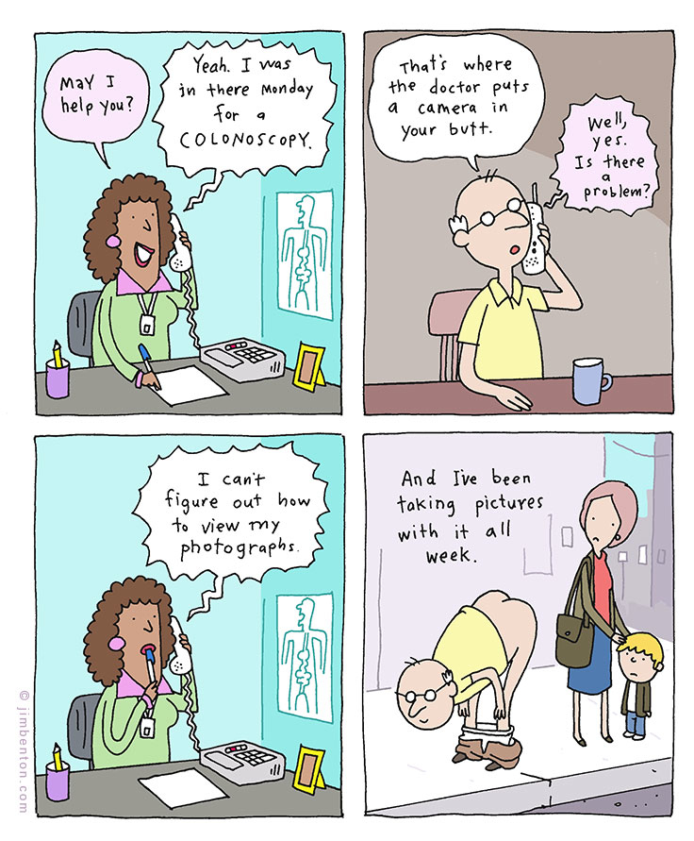
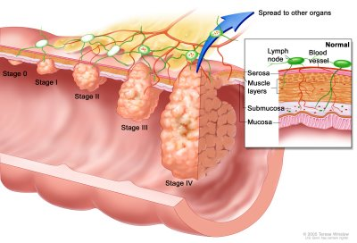
Improvement Projects
Worked on increasing colorectal cancer screening rates
http://www.jimbenton.com/page14/files/JimBentonComic-Colonoscopy.jpg
http://static1.1.sqspcdn.com/static/f/651878/11855946/1303487854690/colon.jpg?token=sii9J4iNI9pZkL9DlhpLFme7cEQ%3D
Notes:
Need to add two more slides or maybe one with two sides

Slide 7
Patients are Safer
I don’t know if you know… Patient that did FOBT
She was POSITIVE
colonoscopy performed
They found an ADENOMA (removed and CURED)
ONCE AGAIN….
62 year old Portuguese guy (did not want a colonoscopy)
I convinced him to do a FOBT - big tumor growing, still within the polyp - CURED
result of us becoming more focused on whatever we had to do in terms of screening. (Full Plate)

Slide 8
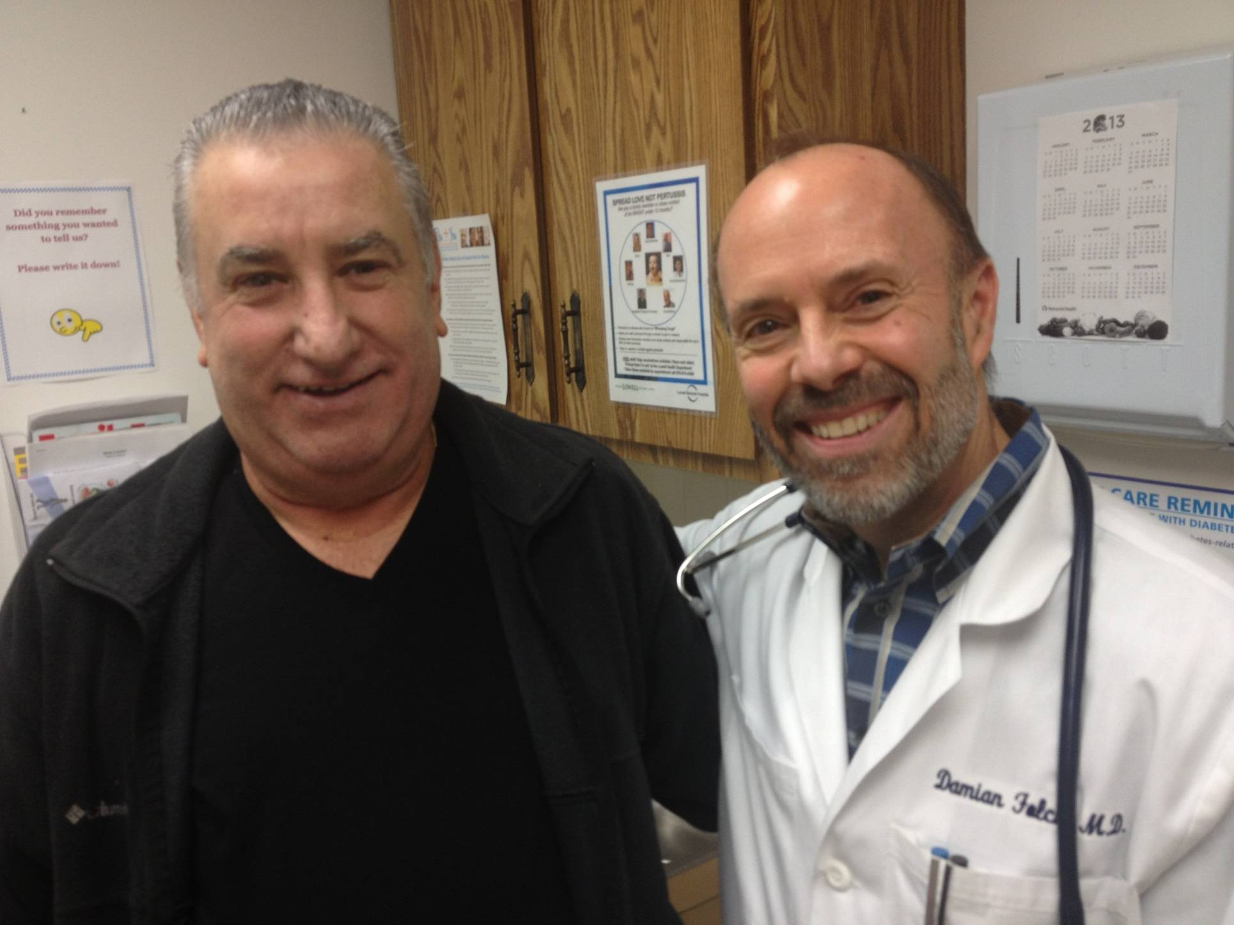
62 year old male after successful partial resection of the colon
Dr. Folch

Slide 9


Improvement Projects
Worked on using patient agenda to solicit patient feedback
http://wardipedia.org/wp-content/uploads/2012/06/46-patients-views-10.png
https://acupatient.com/wp-content/uploads/2014/09/patient_survey_for_acupuncturist_by_acupatient.jpg

Slide 10
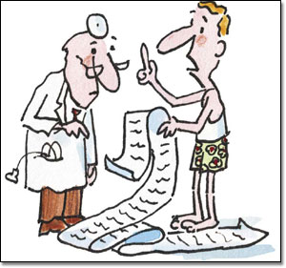
Improvement Projects
Applied Inquiry Technique - asking patients “what else?”
http://www.boeing.com/news/frontiers/archive/2003/october/photos/oct_frontiersfeature.jpg

Slide 11
Gems from PROMISES
The importance of:
  Testing small
  Teamwork: involving your staff
  Community Learning Sessions: you are not alone, learn from and with each other
  Coaches: provides rhythm to keep on track

Slide 12

Advice to Mt. Auburn Practices
Create a culture of Patient Safety
Begin staff meetings asking if there are any Patient Safety Issues
Make safety a priority in the office - lead by example
Empower your staff to identify and communicate to you any patient safety issues
Discuss in detail with the staff when we make a mistake

Slide 13
My plans for the future
Ask patients to identify patient safety issues in my office
Have a patient participate in a staff meeting about patient safety issues
Have a suggestions box

Slide 14
Questions?

